Slide 1
Morse Code Interfacing
Team 18
Carmen Hurtado
Aymane El Jerari
Michelle Imogu

Slide 2
TABLE OF CONTENTS
01.
02.
03.
04.
05.
06.
Goals & Motivations
Functionality
Specifications
Block Diagram
Code Snippet
SUccesses & Failures

Slide 3
Goals & Motivations
Fun Morse Code Game
VGA, FPGA, Keyboard, 7 Seg Display
Best Game of the Century
Fight to revive the Legacy of Morse Code
Notes:
The best Morse Code Game ever made
We made it to revive the Legacy of morse code.
Audience: People who wanna refine their morse code skills.
Christmas gift for children to get them off of screens and the internet

Slide 4
Functionality
The function of our creation is to:
Have a Morse Code flash on the VGA.
Input/type in “guess” of the code into the keyboard.
The Verilog code compares the input with the preset word.
The text will be shown on the FPGA’s 7-segment display.
If correct, VGA would display a Green screen, if not, Red.

Slide 5
Specifications
VGA DISPLAY
Need a 25 Mhz clock to run the display
Need to create a clock of about 0.5 Hz for flashing Morse code in the screen
MORSE ENCODING
Using Minimal Bit Width Encoding, need 2 bits to encode 4 possibilities (dot, dash,espace,done)
KEYBOARD ENCODING/MORSE DECODER
Create a decoder to translate from morse to ASCII values
DISPLAYING TEXT
Need a 10 Khz clock for displaying all the letters at once
Minimum of 32 Bits to represent 26 letters
Create specific patterns for seven segment for each letter
Notes:
VGA DISPLAY: 640x480 screen needs a 25 Mhz clock to display. And also needed a different clock at a visible frequency to flash the morse code shapes to the player.
MORSE ENCODING: 2 BITS WITH 4 POSSIBLE VALUES. DOT-00, Dash-01, Space-10, Done-11. This is how we encode letters and words
KEYBOARD ENCODING/ MORSE DECODER: We needed a way to decode any input morse, for this we gave each keyboard ascii representation a morse code and created a lookup table
Displaying text: Original idea was use the VGA for text display but became very difficult to achieve. Instead we are using the seven segment display with a clock of 10 khz for all the letters to show at a time. To encode this letters since we have 26 letters in the alphabet, we needed a minimum of 32 bits to encode it in a simpler way, or per say a simpler pattern. This would make communication between modules have an easier implementation. We also had to create the different pattern for the lights on each of the seven segments for each of the letters we wanted to display. Some of the letters are possible to do capital and some can only be done in small letters.

Slide 6
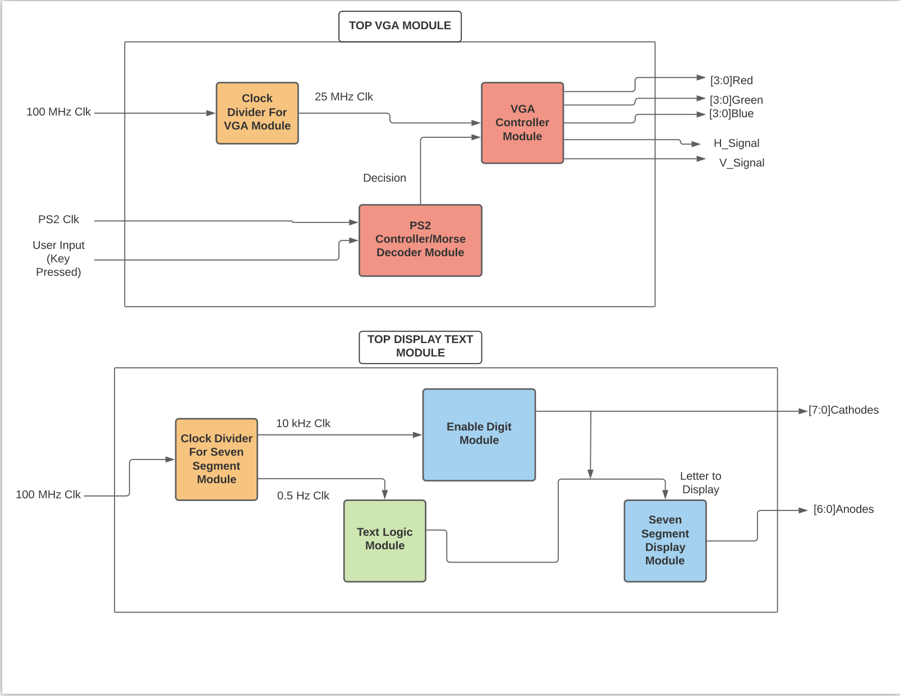
Block Diagram

Slide 7
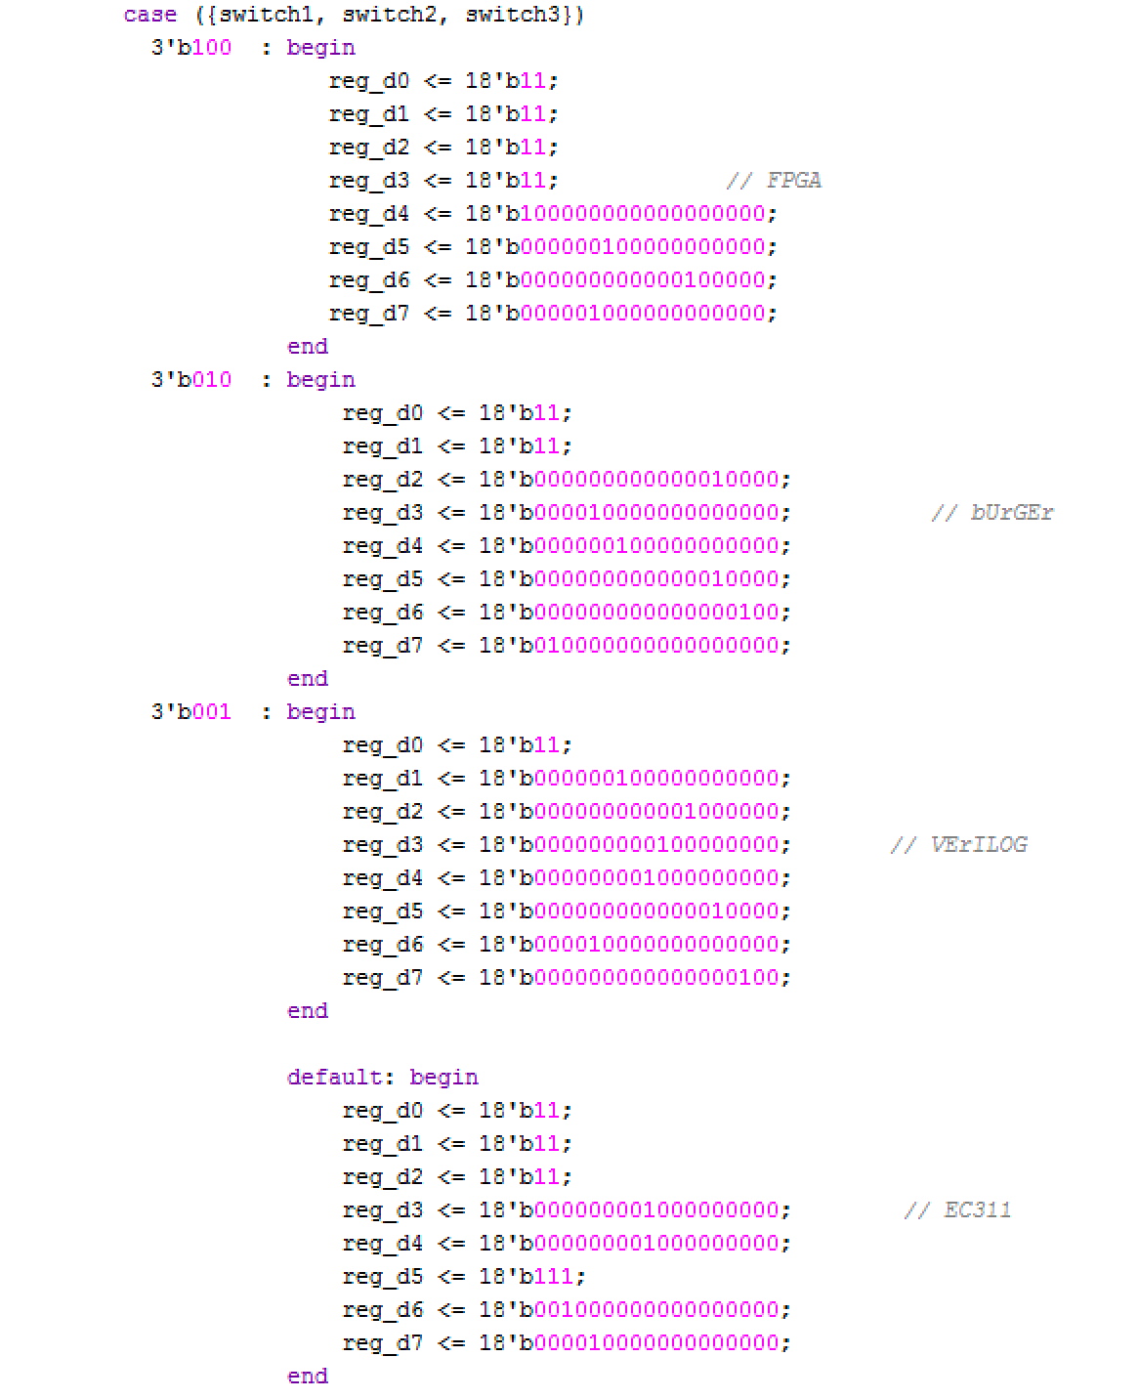
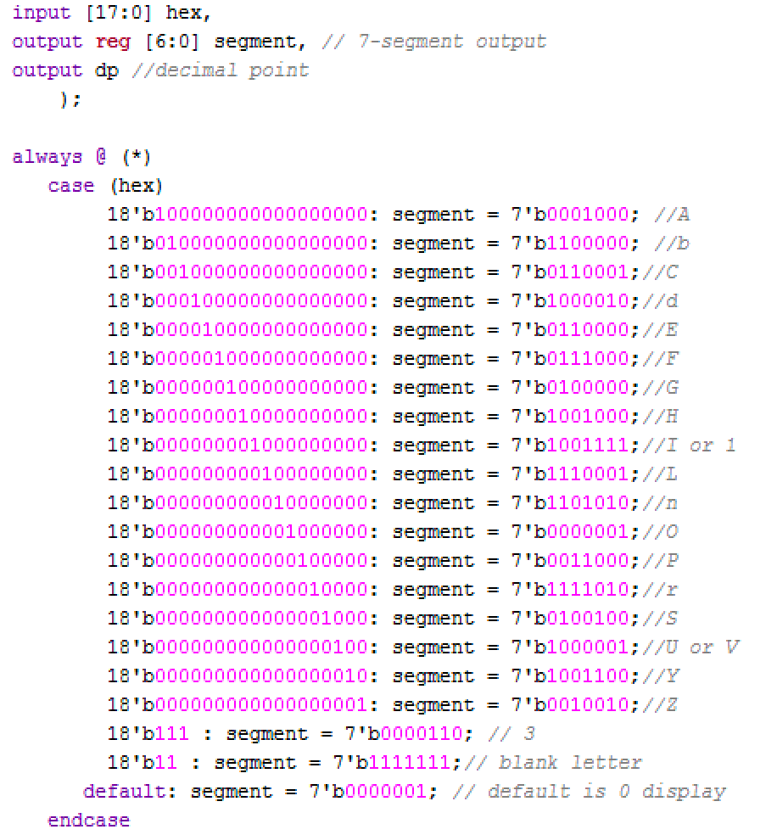
Code Snippets #1

Slide 8

SHORT DEMO #1

Slide 9
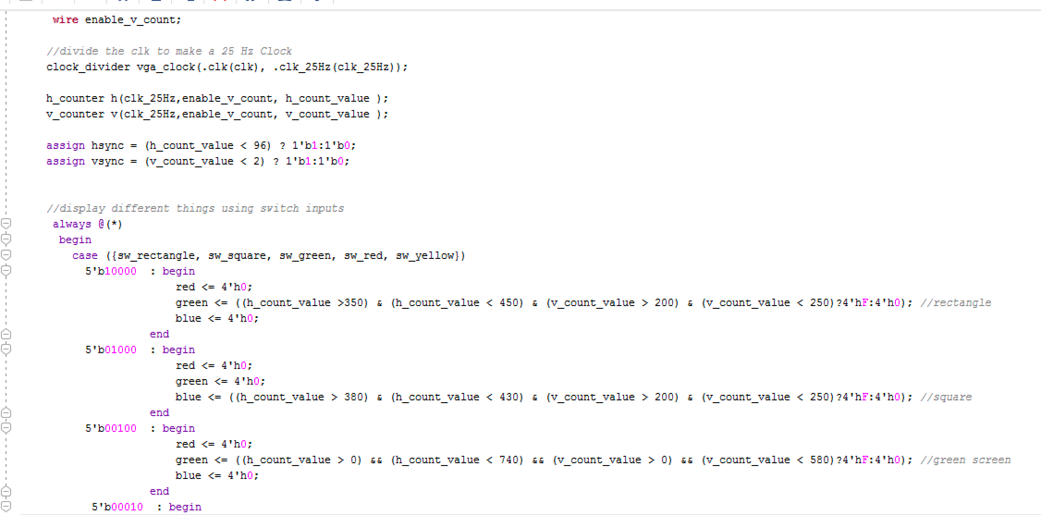
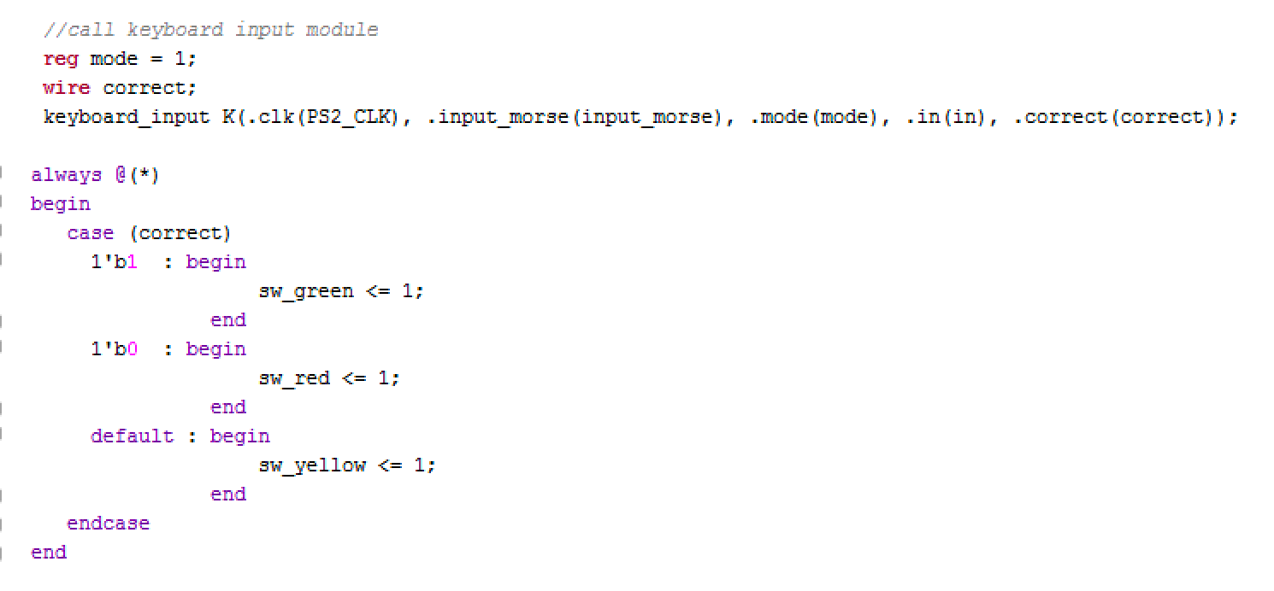
Code Snippets # 2
Notes:
Changing what is displaying on the screen with switches input
Trying to call on keyboard input and receiving a value from the output to decide on user’s guess.

Slide 10
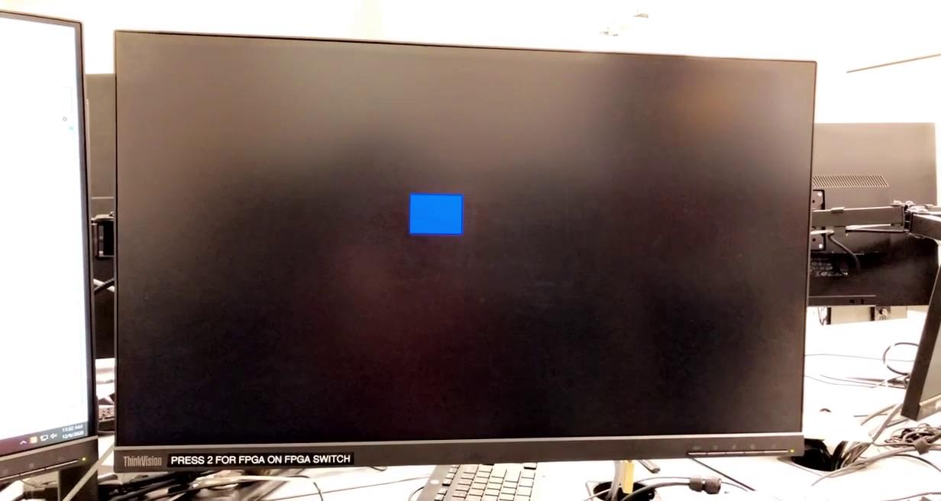
Short Demo # 2

Slide 11
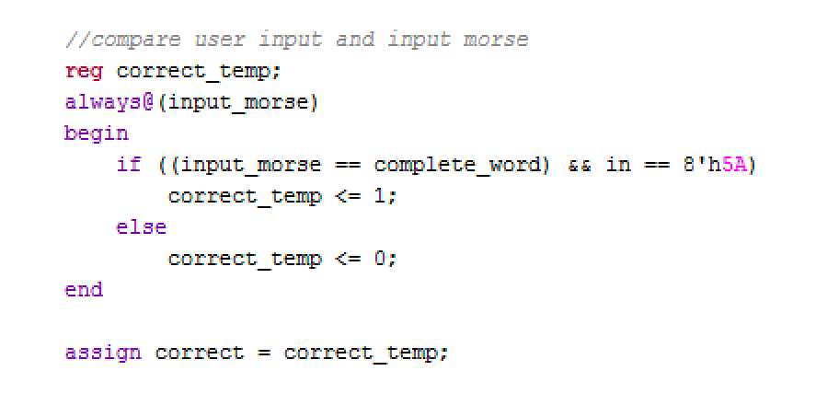
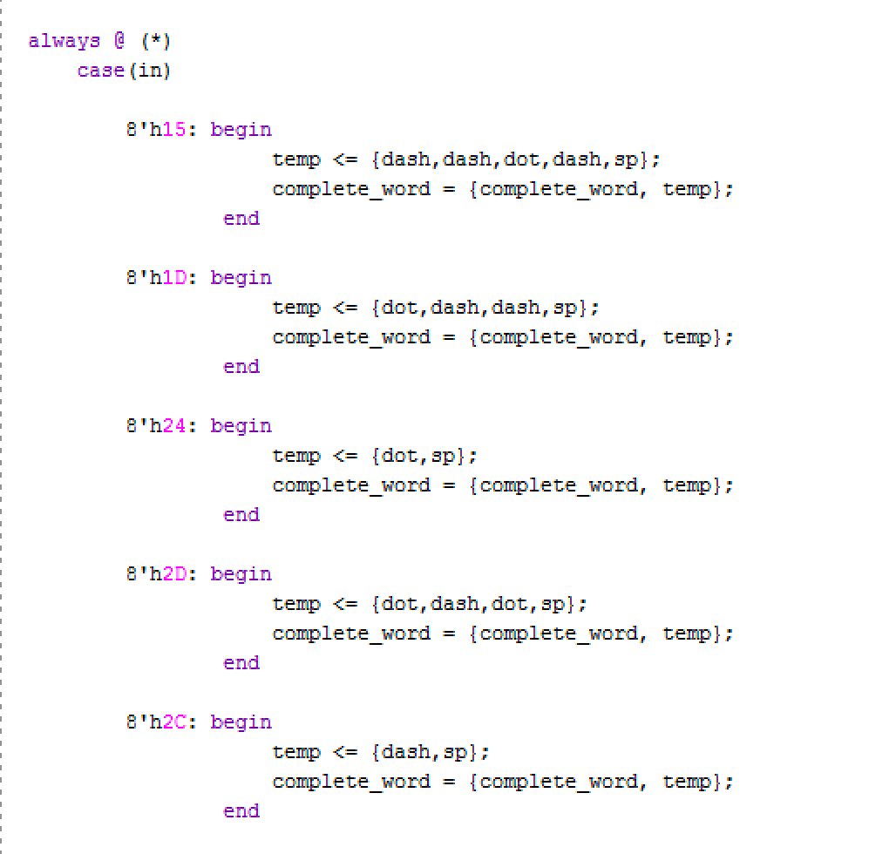
Code Snippets #3

Slide 12
Successes
Failures
VGA
User can input morse code using switches, display at the same time and save the value for future use in the game.
FPGA
The FPGA is able to display letters on the 7-segment to form (short) words
Verify Input correctness
Green/Red Screens
Inputs
Keyboard
Switches
Minimum Bit Width Encoding
VGA
No text display
Dynamically and automatic display of Morse Code
FPGA (7-segment display)
Was difficult to manipulate the display of words with switches/buttons
Multiplayer Mode
Uppercase/Lowercase

Slide 13
- .... .- -. -.- / -.-- --- ..- / ..-. --- .-. / -.-- --- ..- .-. / .- - - . -. - .. --- -. -.-.--
.- -. -.-- / --.- ..- . ... - .. --- -. ... ..--..

